Slide 1


Genealogy
Merit Badge
Troop 344 and 9344
Pemberville, OH

Slide 2

Genealogy Requirements
Explain to your counselor what the words genealogy, ancestor, and descendant mean.
Do ONE of the following:
  Do a time line for yourself or for a relative. Then write a short biography based on that time line.
  Keep a journal for 6 weeks. You must write in it at least once a week.
With your parent's help, choose a relative or a family acquaintance you can interview in person, by telephone, or by e-mail or letter. Record the information you collect so you do not forget it.

Slide 3

Genealogy Requirements
Do the following:
  Name three types of genealogical resources and explain how these resources can help you chart your family tree.
  Obtain at least one genealogical document that supports an event that is or can be recorded on your pedigree chart or family group record. The document could be found at home or at a government office, religious organization, archive, or library.
  Tell how you would evaluate the genealogical information you found for requirement 4b.

Slide 4
Genealogy Requirements
Contact ONE of the following individuals or institutions. Ask what genealogical services, records, or activities this individual or institution provides, and report the results:
  A genealogical or lineage society
  A professional genealogist (someone who gets paid for doing genealogical research)
  A surname organization, such as your family's organization
  A genealogical education facility or institution.
  A genealogical record repository of any type (courthouse, genealogical library, state or national archive, state library, etc.)

Slide 5
Genealogy Requirements
Begin your family tree by listing yourself and include at least two additional generations. You may complete this requirement by using the chart provided or the genealogy software program of your choice.
Complete a family group record form, listing yourself and your brothers and sisters as the children. On another family group record form, show one of your parents and his or her brothers and sisters as the children. This requirement may be completed using the chart provided or the genealogy software program of your choice.

Slide 6
Genealogy Requirements
Do the following:
  Explain the effect computers and the Internet are having on the world
  of genealogy.
  Explain how photography (including microfilming) has influenced genealogy.
Discuss what you have learned about your family and your family members through your genealogical research.

Slide 7
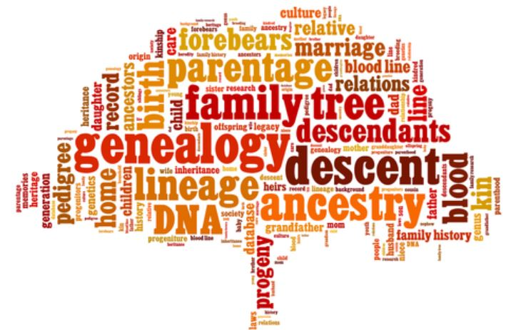
Requirement 1
Explain to your counselor what the words genealogy, ancestor, and descendant mean.

Slide 8
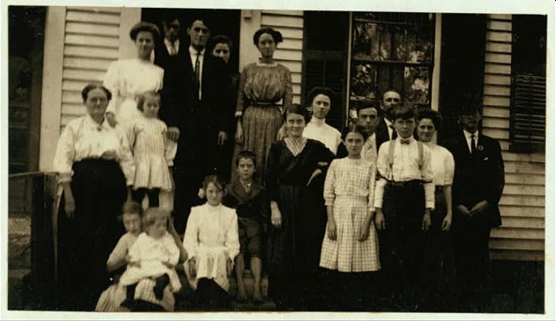
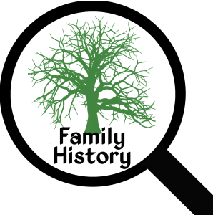
Requirement 1
Genealogy is the study or investigation of ancestry and family histories.
  Who were they?
  Where did they live?
  What were they like?
Ancestor is one from whom a person is descended and who is usually more remote in the line of descent than a grandparent.
Descendent is someone who is related to a person or group of people who lived in the past

Slide 9
Requirement 2
Do ONE of the following:
  Do a time line for yourself or for a relative. Then write a short biography based on that time line.
  Keep a journal for 6 weeks. You must write in it at least once a week.

Slide 10
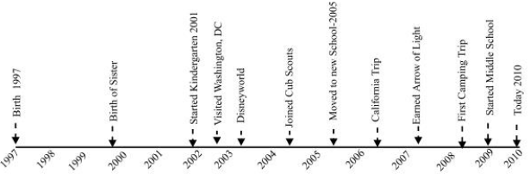
Requirement 2a
A timeline is a chart that shows the events in a person’s life.
Your timeline should include at least 10 items.
You can make a timeline for yourself or for another relative.
Show events that were important in your life or your relative’s life.
  Your birth
  Births of brothers or sisters
  Starting school
  Sports
  Music
  Vacations
  Health problems
  Dates of community or world events
Write a short biography based on your timeline.

Slide 11

Requirement 2b
Writing a Journal
  Write in your journal on a regular basis (at least once a week for six weeks).
  It is a log of your activities, thoughts, and feelings and may include the following:
    Where you live and the room you sleep in.
    What you ate that day.
    Your likes and dislikes
    The people you live with.
    Other relatives and friends.
    What happened in school or with your friends
    After-school and weekend activities
    Your future plans
  The journals of our ancestors can help us understand what their lives were really like.

Slide 12
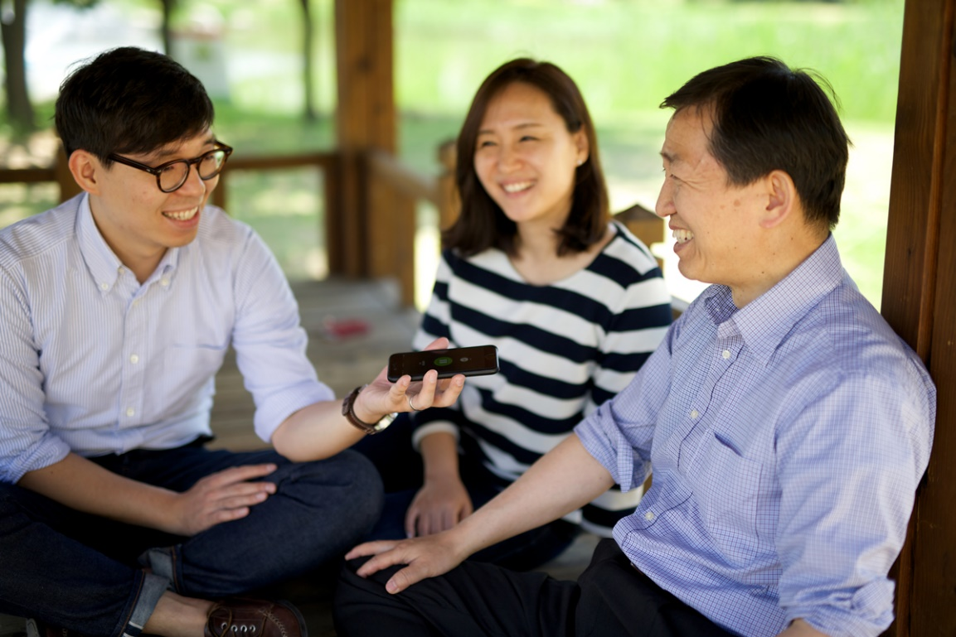
Requirement 3
With your parent's help, choose a relative or a family acquaintance you can interview in person, by telephone, or by e-mail or letter. Record the information you collect so you do not forget it.

Slide 13
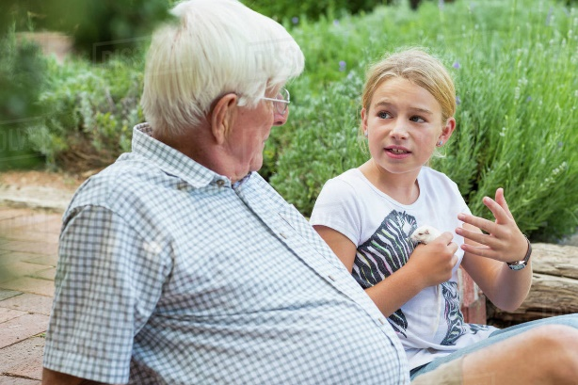
Gathering information from a relative or family acquaintance.
Requirement 3
You might ask about the following:
  Their full names.
  What they do (or did) for a living.
  The names of their parents, brothers, and sisters.
  What their clothes, food, and homes were like when they were growing up.
  Where they lived and what the community was like.
  Community activities they were involved in.
  Military service and what it was like.
  Choices they made in life; such as whether or not to go to college or to take a certain job.
  Stories of things that happened to them – the funniest one, the most embarrassing one, the one they learned the most from, or the one they feel is most important to share with you.
Record the information.

Slide 14
Requirement 4
Do the following:
  Name three types of genealogical resources and explain how these resources can help you chart your family tree.
  Obtain at least one genealogical document that supports an event that is or can be recorded on your pedigree chart or family group record. The document could be found at home or at a government office, religious organization, archive, or library.
  Tell how you would evaluate the genealogical information you found for requirement 4b.

Slide 15
Genealogical Resources
Requirement 4a
Family Sources
  Address books
  Adoption records
  Baby announcements
  Baby books
  Baptismal certificates
  Diaries or other ancestral writings
  Family Bibles
  Family correspondence or interviews
  Family pictures
  Letters, diaries and journals
  Living relatives
  Marriage certificates, wedding invitations, and marriage announcements
  Military documents
  Newspaper clippings
  Obituaries
  Oral histories
  Personal items and papers
  Photographs and photo albums
  School records
  Scrapbooks
  Wedding announcements
  Wills

Slide 16
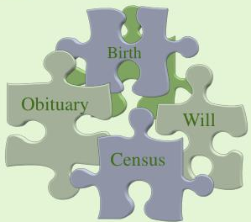
Genealogical Resources
Requirement 4a
Published Sources
  Census records
  Tax records
  Land deeds
  Books and microfilm resources in a library
  Church histories
  City/town histories
  Fraternal organization publications
  Genealogical periodicals
  Histories of settlers in area
  Local histories
  Newspapers
  State/local genealogy society

Slide 17
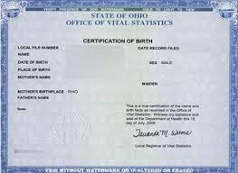
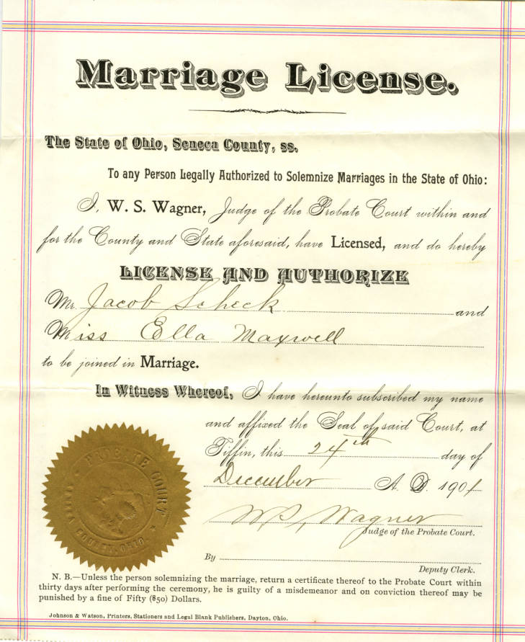
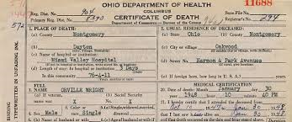
Genealogical Resources
Requirement 4a
Vital Records
  Birth records
  Court papers
  Death records
  Marriage records
  Probate Records
  Wills

Slide 18
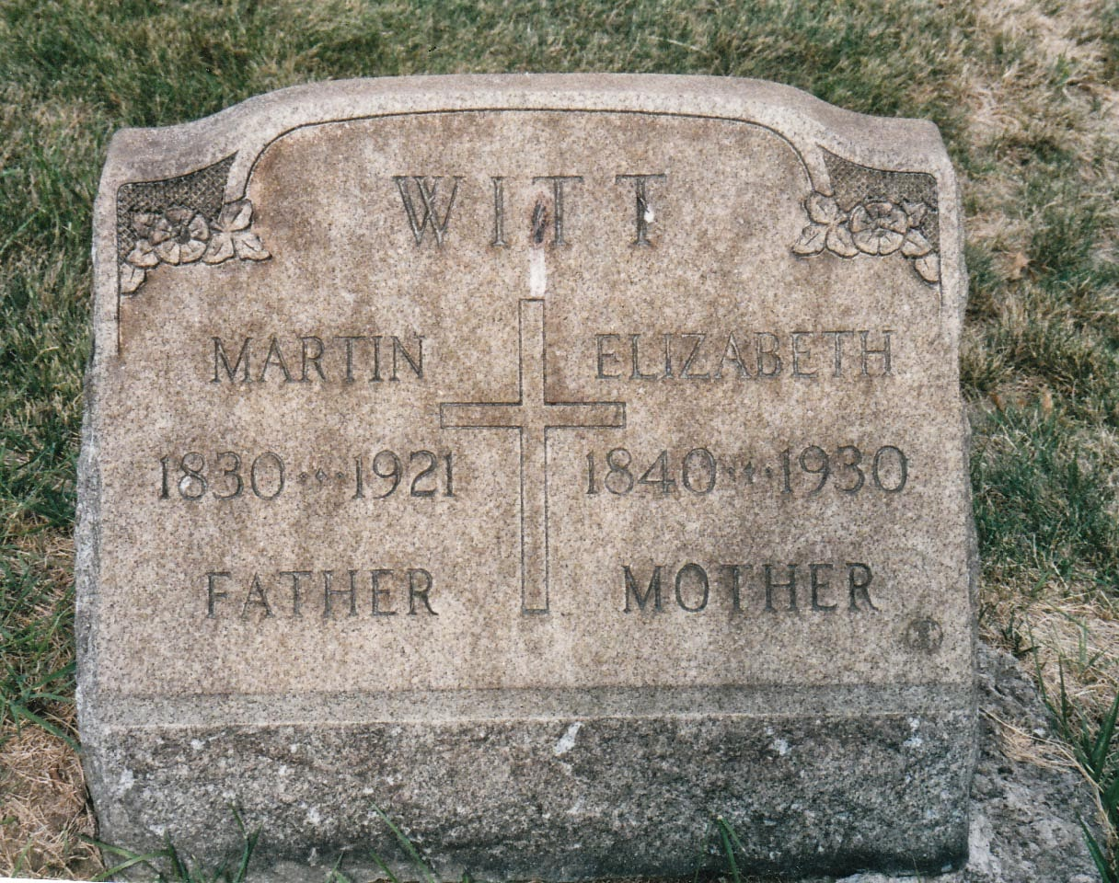

Genealogical Resources
Requirement 4a
Other Genealogical Records
  Cemetery records and tombstones
  Emigration/Immigration records
  Neighbors and friends
  Veterans organizations
  Voters' Registration

Slide 19
Deciding Which Records to Use
Requirement 4a
Step 1 – Decide what you want to find out.
Step 2 – Find out what kind of record will give you that information.
Step 3 – Find out where the records you need can be found.
New information enables you to ask new questions.

Slide 20
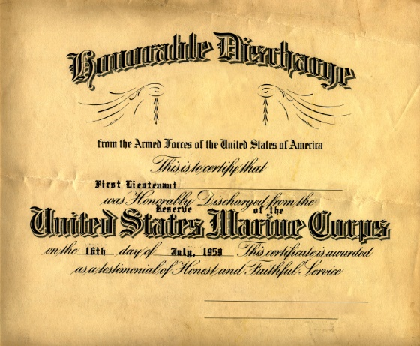
Genealogical Documents
Requirement 4b
The most important documents for genealogists are:
  Vital records (birth, marriage, and death certificates)
  Religious records.
  Cemetery records.
  Census forms.
  Citizenship papers.
  Military records.
  Other records like school records, deeds, and wills.
Ask your family if they have copies of any of the above.
A great website to search for missing vital records, such as marriage records, birth records and death records in Ohio is the Ohio Office of Vital Statistics.

Slide 21
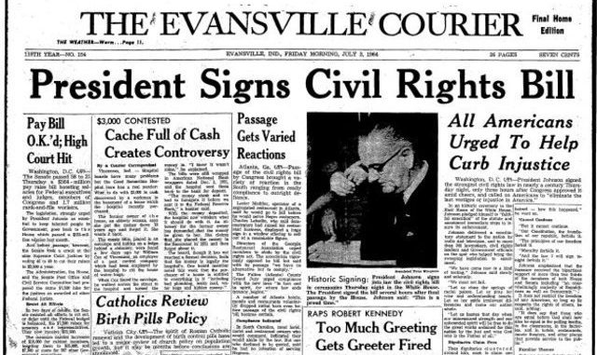
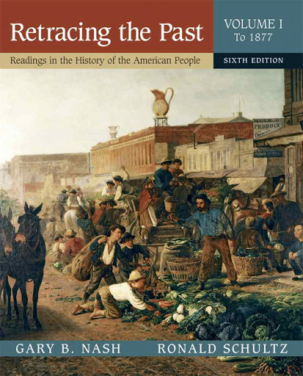
Evaluating Genealogical Information
Requirement 4c
A primary source is any record created during the time you are researching, i.e. an eyewitness account. Primary sources can take many forms, such as newspapers, letters, journals, tax lists, court documents, church records, or a census.
Secondary sources are documents, oral accounts, and records that are created some length of time after the event or for which information is supplied by someone who wasn't an eyewitness to the event. A secondary source can also be a person who was an eyewitness to the event but recalls it after significant time passes.

Slide 22
Evaluating Genealogical Information
Requirement 4c
Collecting records is not enough—you must be able to understand what the record says, how it relates to your research problem, and whether or not you should believe the information.
Consider the following factors in evaluating the reliability of information:
  Examine the sources attached to the information. Is there any bias that might have affected the account. Is it a primary or a secondary source. The further you get from the original record, the more likely errors have been introduced. Try to find primary sources for the information you’ve discovered.
  Determine the validity of the source. Is it an original record, such as a passenger list? A transcription?
  Evaluate the time between the event and when the source you’ve found was created. People relying on their memory of a date or place may not remember it accurately.

Slide 23
Requirement 5
Contact ONE of the following individuals or institutions. Ask what genealogical services, records, or activities this individual or institution provides, and report the results:
  A genealogical or lineage society
  A professional genealogist (someone who gets paid for doing genealogical research)
  A surname organization, such as your family's organization
  A genealogical education facility or institution.
  A genealogical record repository of any type (courthouse, genealogical library, state or national archive, state library, etc.)

Slide 24

Genealogical Societies
Requirement 5a
The Ohio Genealogical Society can help you find the right material for your research, and help you discover more about your early Ohio ancestors and the contributions they made to their communities.
Wood County Genealogical Society - assists individuals interested in genealogy in tracing their ancestors, with emphasis to Wood County. WCGS also receives, collects, purchases, and preserves manuscripts, books, records, and family histories and makes them available for use in genealogical research.

Slide 25

Professional Genealogists
Requirement 5b
Trace ancestry
Research descendants
Search records
To locate a Professional Genealogist, start with the website for the Association of Professional Genealogists.
  Here you can browse through either a list of genealogists by name, location, research specialty, or geographic specialty.

Slide 26


Surname Organization
Requirement 5c
A family association or family organization formed by people who share a common ancestor or surname.

Slide 27

Genealogical Education Institution
Requirement 5d
The National Genealogical Society is a genealogical interest group founded in 1903 in Washington, D.C.. Its headquarters are in Falls Church, Virginia.
The goals of the organization are to promote genealogical skill development, establish high standards of genealogical research, and increase awareness of and interest in family history.

Slide 28

Genealogical Record Repository
Requirement 5e
Library of Congress
National Archives and Records Administration
Your local public library
University libraries
County record offices
Local genealogy societies
The internet

Slide 29
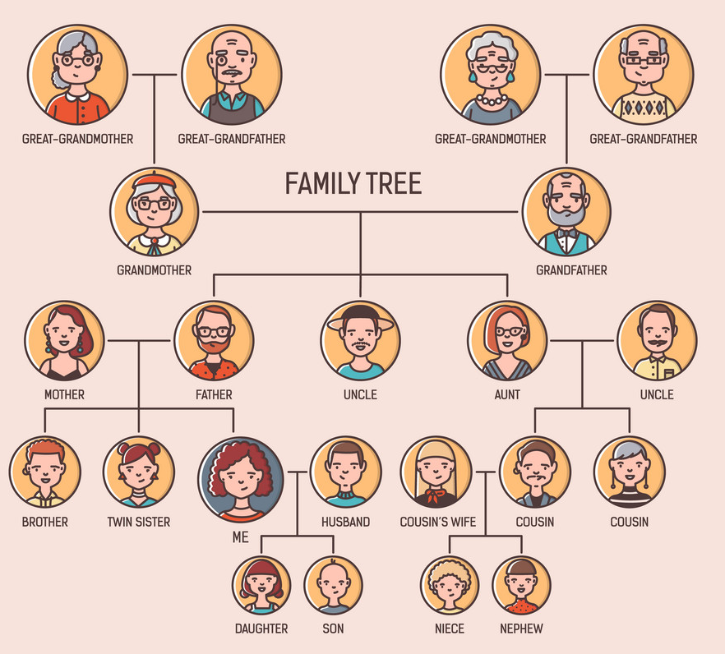
Requirement 6
Begin your family tree by listing yourself and include at least two additional generations. You may complete this requirement by using the chart provided or the genealogy software program of your choice.

Slide 30
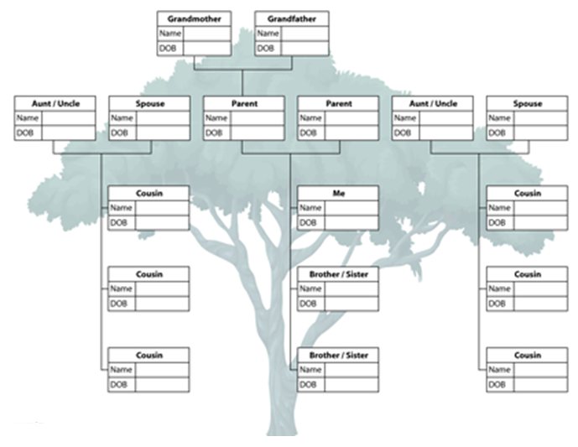
Family Tree
Requirement 6

Slide 31
Requirement 7
Complete a family group record form, listing yourself and your brothers and sisters as the children. On another family group record form, show one of your parents and his or her brothers and sisters as the children. This requirement may be completed using the chart provided or the genealogy software program of your choice.

Slide 32
Requirement 7
Write down where you found your information.
Include a list of ideas about where to look for more information.

Slide 33
Requirement 8
Do the following:
  Explain the effect computers and the Internet are having on the world of genealogy.
  Explain how photography (including microfilming) has influenced genealogy.

Slide 34
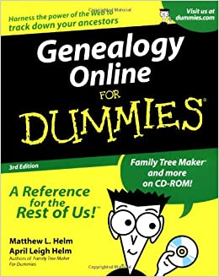
Computers, the Internet, and Genealogy
Requirement 8a
Technology has given genealogists the means to conduct, compile and store information from the comfort of their own homes.
Genealogists are now able to use scanners to scan old photographs, forever preserving them for future generations.
Genealogical software allows researchers to compile information, ridding themselves of the many boxes and filing cabinets once necessary to organize this type of information.
The internet has given researchers the ability to access information, formally available only at libraries and government offices.
Researchers are now able to share information within seconds instead of waiting days or weeks for documents to travel through the postal system.

Slide 35
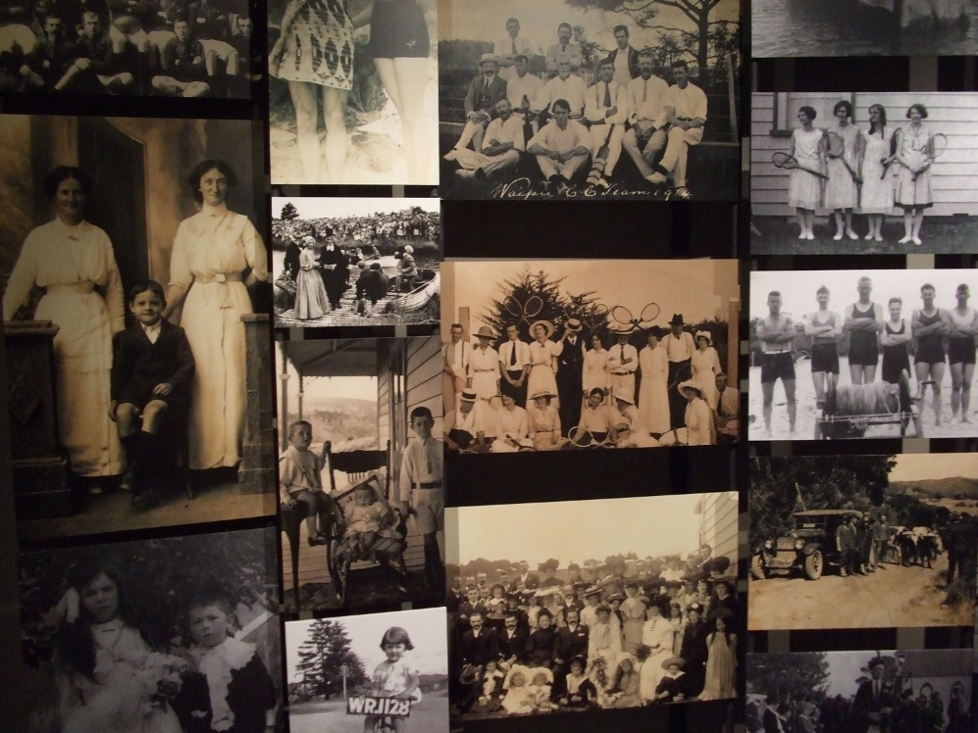
Photography and Genealogy
Requirement 8b
In genealogical research, photography can be used for more than just showing what people looked like.
Photographs may help you pinpoint family members at a specific place in time.
Such photographs may also help to confirm the death of certain individuals and the presence of others that had not been previously known to exist.
We need to identify our own photographs so that our history is not forgotten.

Slide 36

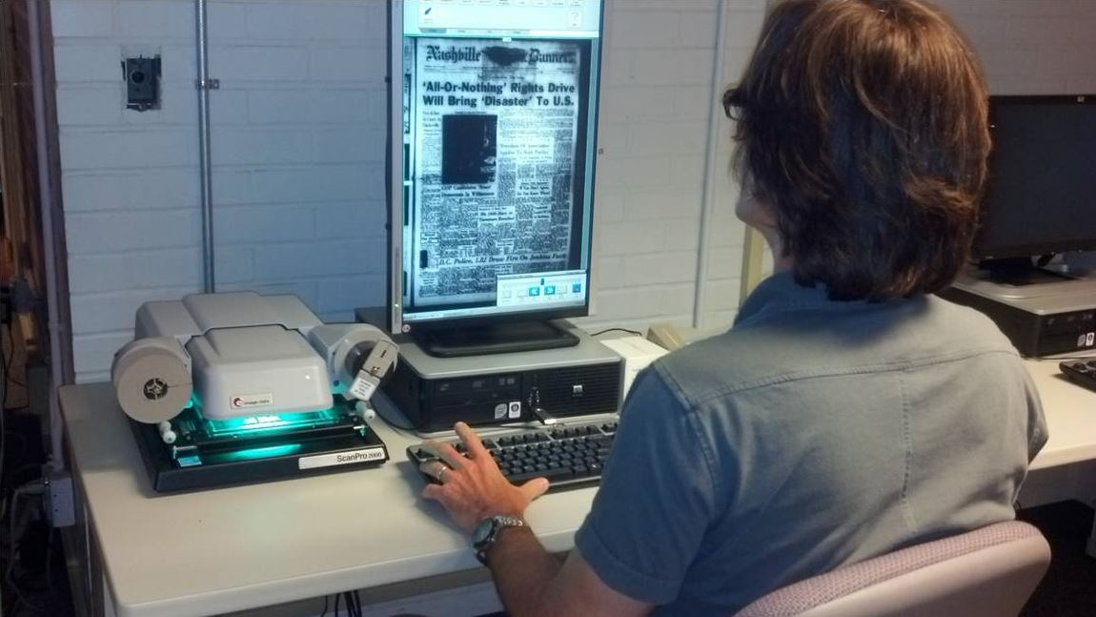
Microfilm and Genealogy
Requirement 8b
Archives captured on microfilm and microfiche have done a remarkable job of preserving history.
Records maintained on microfilm include: census records, immigration and military records, birth, marriage and death certificates, newspapers, magazines, etc.
Many of these are available in local, state, and national archives.
Microfilm is being phased out as it is digitized and posted on the internet.

Slide 37
Requirement 9
Discuss what you have learned about your family and your family members through your genealogical research.

